Slide 1
FIRE EVACUATION PLAN FOR PHDU

Slide 2
INTRODUCTION
Fire evacuation procedure in RH
It is created by the fire prevention department which includes the action to be take by all staff in the event of fire and the arrangements for calling the fire safety officer.
Code red team members during normal working hours
D.G or whoever act
Fire officer
Nursing officer
PRO
Eng controller

Slide 3
Lesson plan
In the event of a fire on the ward all staff must be fully familiar with
The procedure for reporting the fire and calling for assistance
The location of fire fighting equipments and how to use it correctly
The movement of pts to a place of safety
In the very first instance fire is discovered the alarm must be raised
shout fire to bring colleagues immediately to your assistance
Activate the manual fire alarm call point to ring the fire alarm bell
Code 9777
There a number of smoke and heat detectors throughout wards
These will automatically detect fire

Slide 4
SMOKE AND HEAT DETECTORS
There a number of smoke and heat detectors throughout ward
These will automatically detect fire
It is possible that a detector has activated due to a fire concealed in a closed or unoccupied area.
If you hear a continual alarm ringing but are not aware of a fire then check all rooms and check for a smell of smoke or burning.
CHECKING FOR FIRE BEHIND CLOSED DOORS
If you suspect there may be a fire in a closed unoccupied room you must do the following.
Observe the top,the bottom and around the edge of the room to see if smoke visiblly coming from the room.
With your back of the hand only, feel the surface of the door ,particularly towards the top of the door.
If smoke is visible and the door feel excessively hot to the touch DO NOT open it. leave it closed and activate the firm alarm immediately . prepare to evacuate

Slide 5
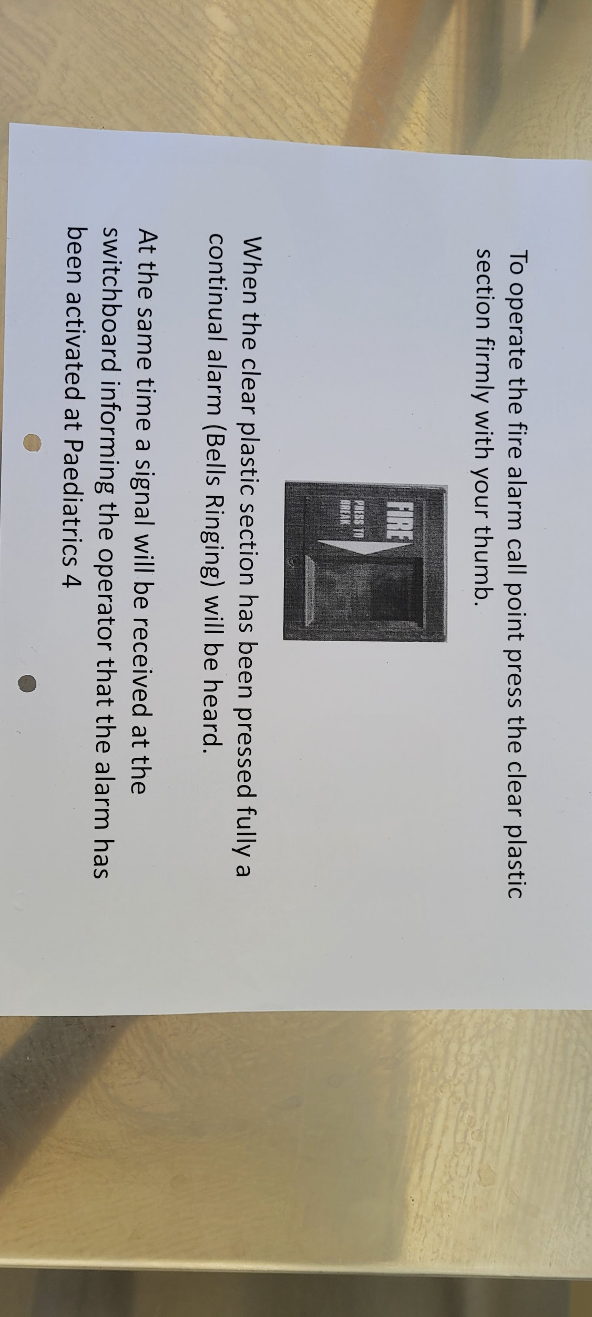

Slide 6
Five classes of fire
Class A - these are commonly flammable material as there fuel sources .
Example -wood ,fabric , paper, trash , plastics
Class B – defined as flammable liquid or gas.
Example - oil, paints ,kerosene, gasoline, flammable gases such as butane or propane are common sources.
Class c – defined as fire that uses electrical components or energized equipments.
Class d- defined as that uses combustible metal as its fuel sources
Example - metal include titanium, magnesium and potasium these are danger in laboratory environments
Class k – defined as cooking fire involving combustion from liquids used in food preparation.

Slide 7
CHARACTERISTICS OF FIRE EXTINGUISHERS
DRY POWDER Fire extinguishers are colored blue or red with light blue band , they are multipurpose can be used for fight solid ,liquid and gas.
FORM fire extinguisher colored cream or red with a cream band ,used to fight solid and liquid fire.
CO2 fire extinguishers are colored black or red with a black band, it can be used to fight , b and c class fire .
At each end of the ward you will find a fire point - in the upper cabinet there is a automatic fire hose reel -in the lower cabinet there are 2 x 6 litres foam extinguisher.

Slide 8
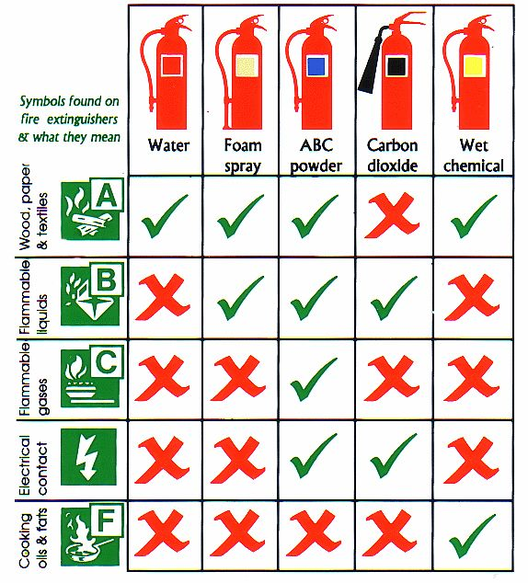
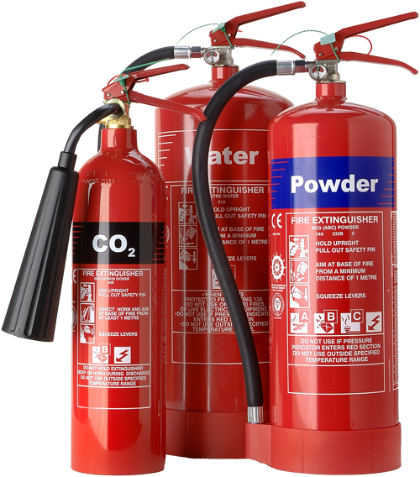

Slide 9
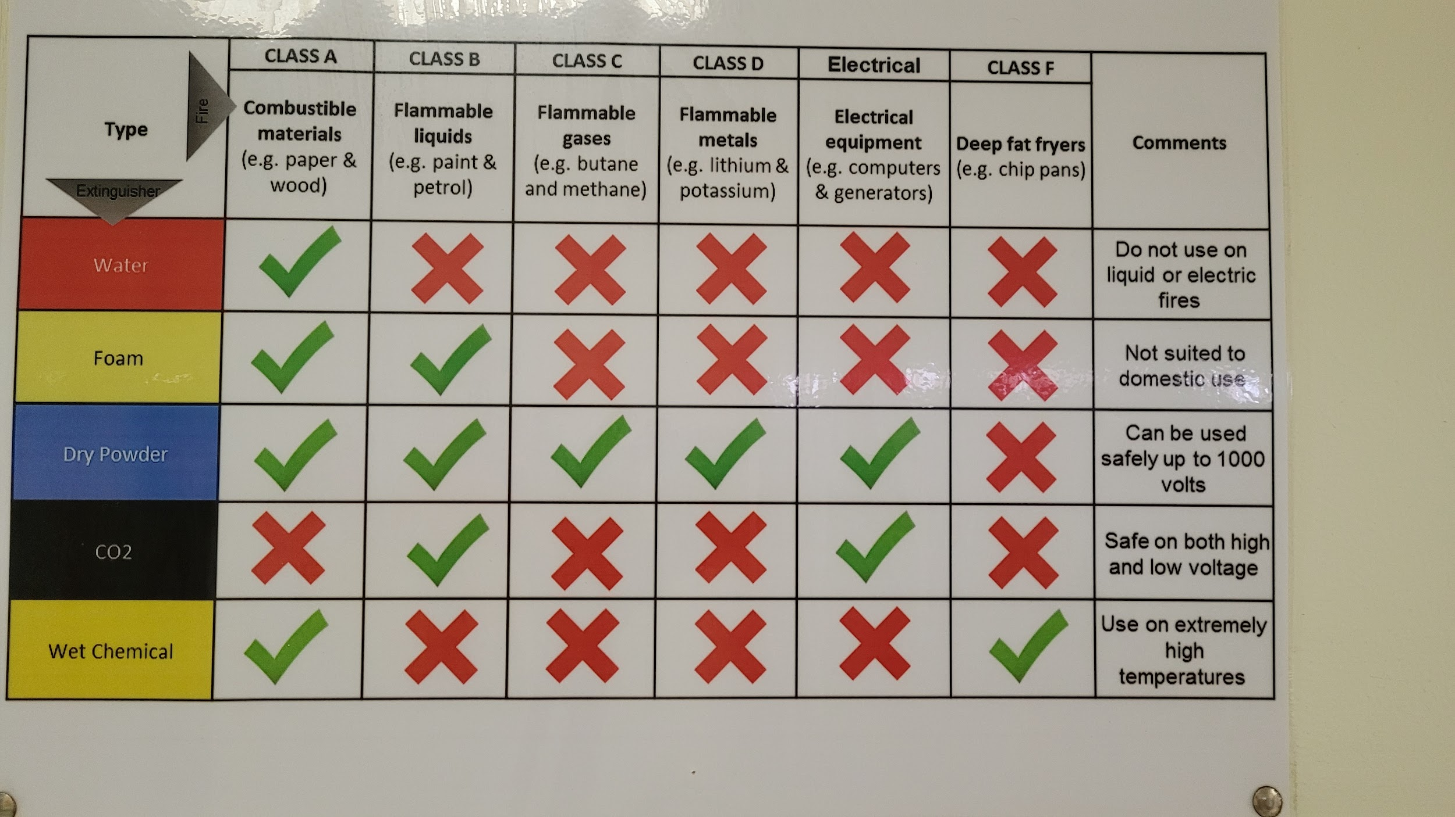

Slide 10
ACTION WHEN HEARING FIRE ALARM
RECOGNITION OF FIRE SOUND
If alarm sound is continuous it means that there is a fire in the ward
If the sound is intermittent the fire is in a nearby ward
Breaking the plastic glass in the nearest break glass call point
Close the door
Call fire emergency [ code red] 9777
Name of the person calling
Location of the fire pw4
Information about the fire
Incharge will decide to evacuate the pt
If any person is missing call control room inform the where last seen call all care givers, extra attenders, staff all should be around
Pt will be evacuated to PW3
Most stable pt will be shifted first followed by the most critical pt

Slide 11
Fire Witness Person
1. Shouting fire 2. Break the fire alarm glass. 3. Close down medical gasses at the break glass control point in the ward. 4. Activate switch board for fire 9777. 5. Help for immediate patients. evacuation to the designated ward .
1. Ensure the activation of fire alarm system . 2. Close down medical gasses at the break glass control point in the ward 3. evaluate the situation for risk during evacuation. 4. start immediate pt evacuation by- * assess the man power availability * arrange enough o2 trolley, monitors, ambubag if possible *evacuate ambulatory pts near the fire zone * semi and non ambulatory pt evacuate by beds and wheel chairs * upon arrival to designated area ensue safe arrival of ts and all health care professionals.
1.Disconnect pt from monitoring and unneeded infusion pumps 2. Upload o2 cylinder on the patient bed [ avoid opening o2 cylinder near fire scene] 3. Start manual ventilation with the ambubag. 4. Gather all pt documents and medication 5. Immediately evacuate the pt to designated area according to fire escape plan . 5. Ensure safe arrival of pt and all health care professionals.
Ward nurse on duty
Bedside nurse

Slide 12
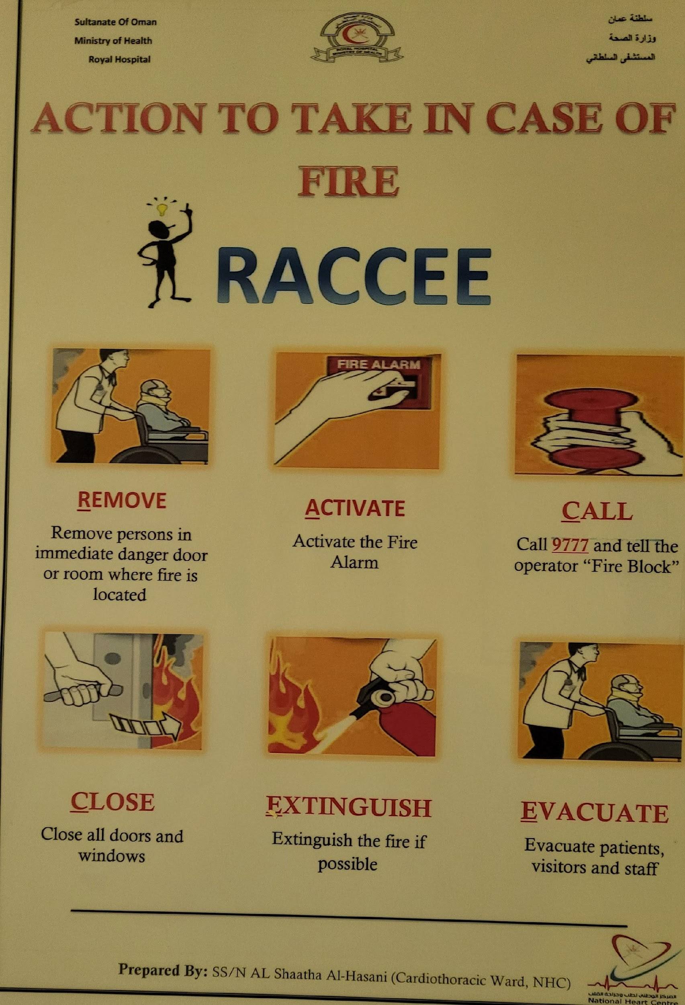
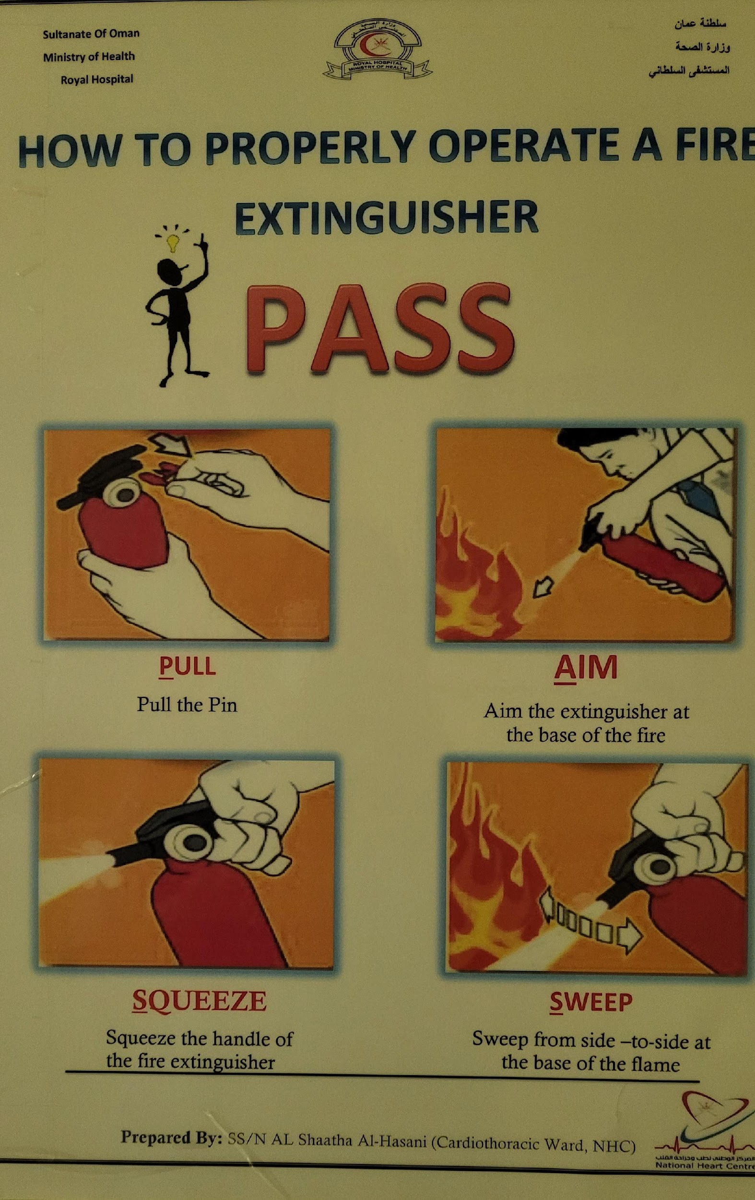

Slide 13
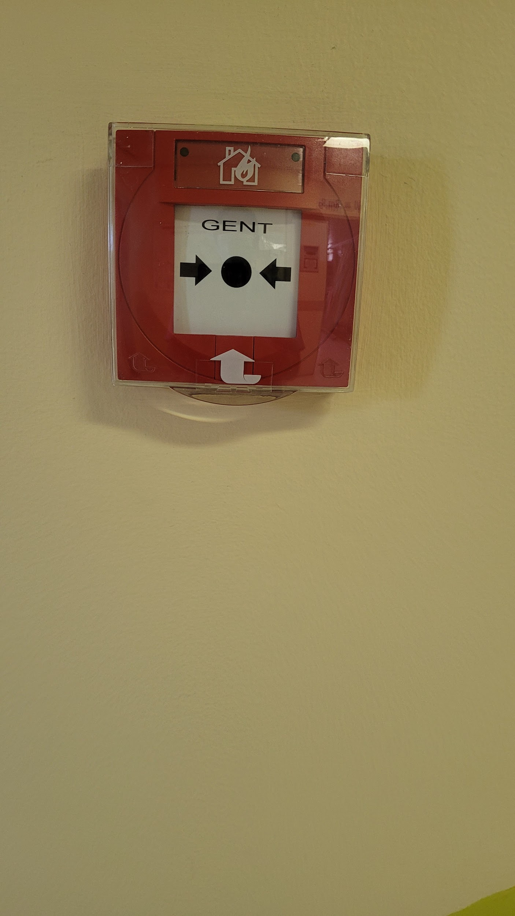
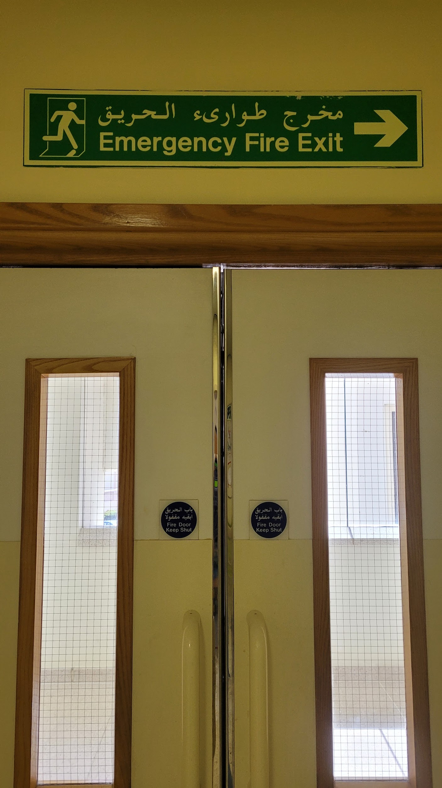
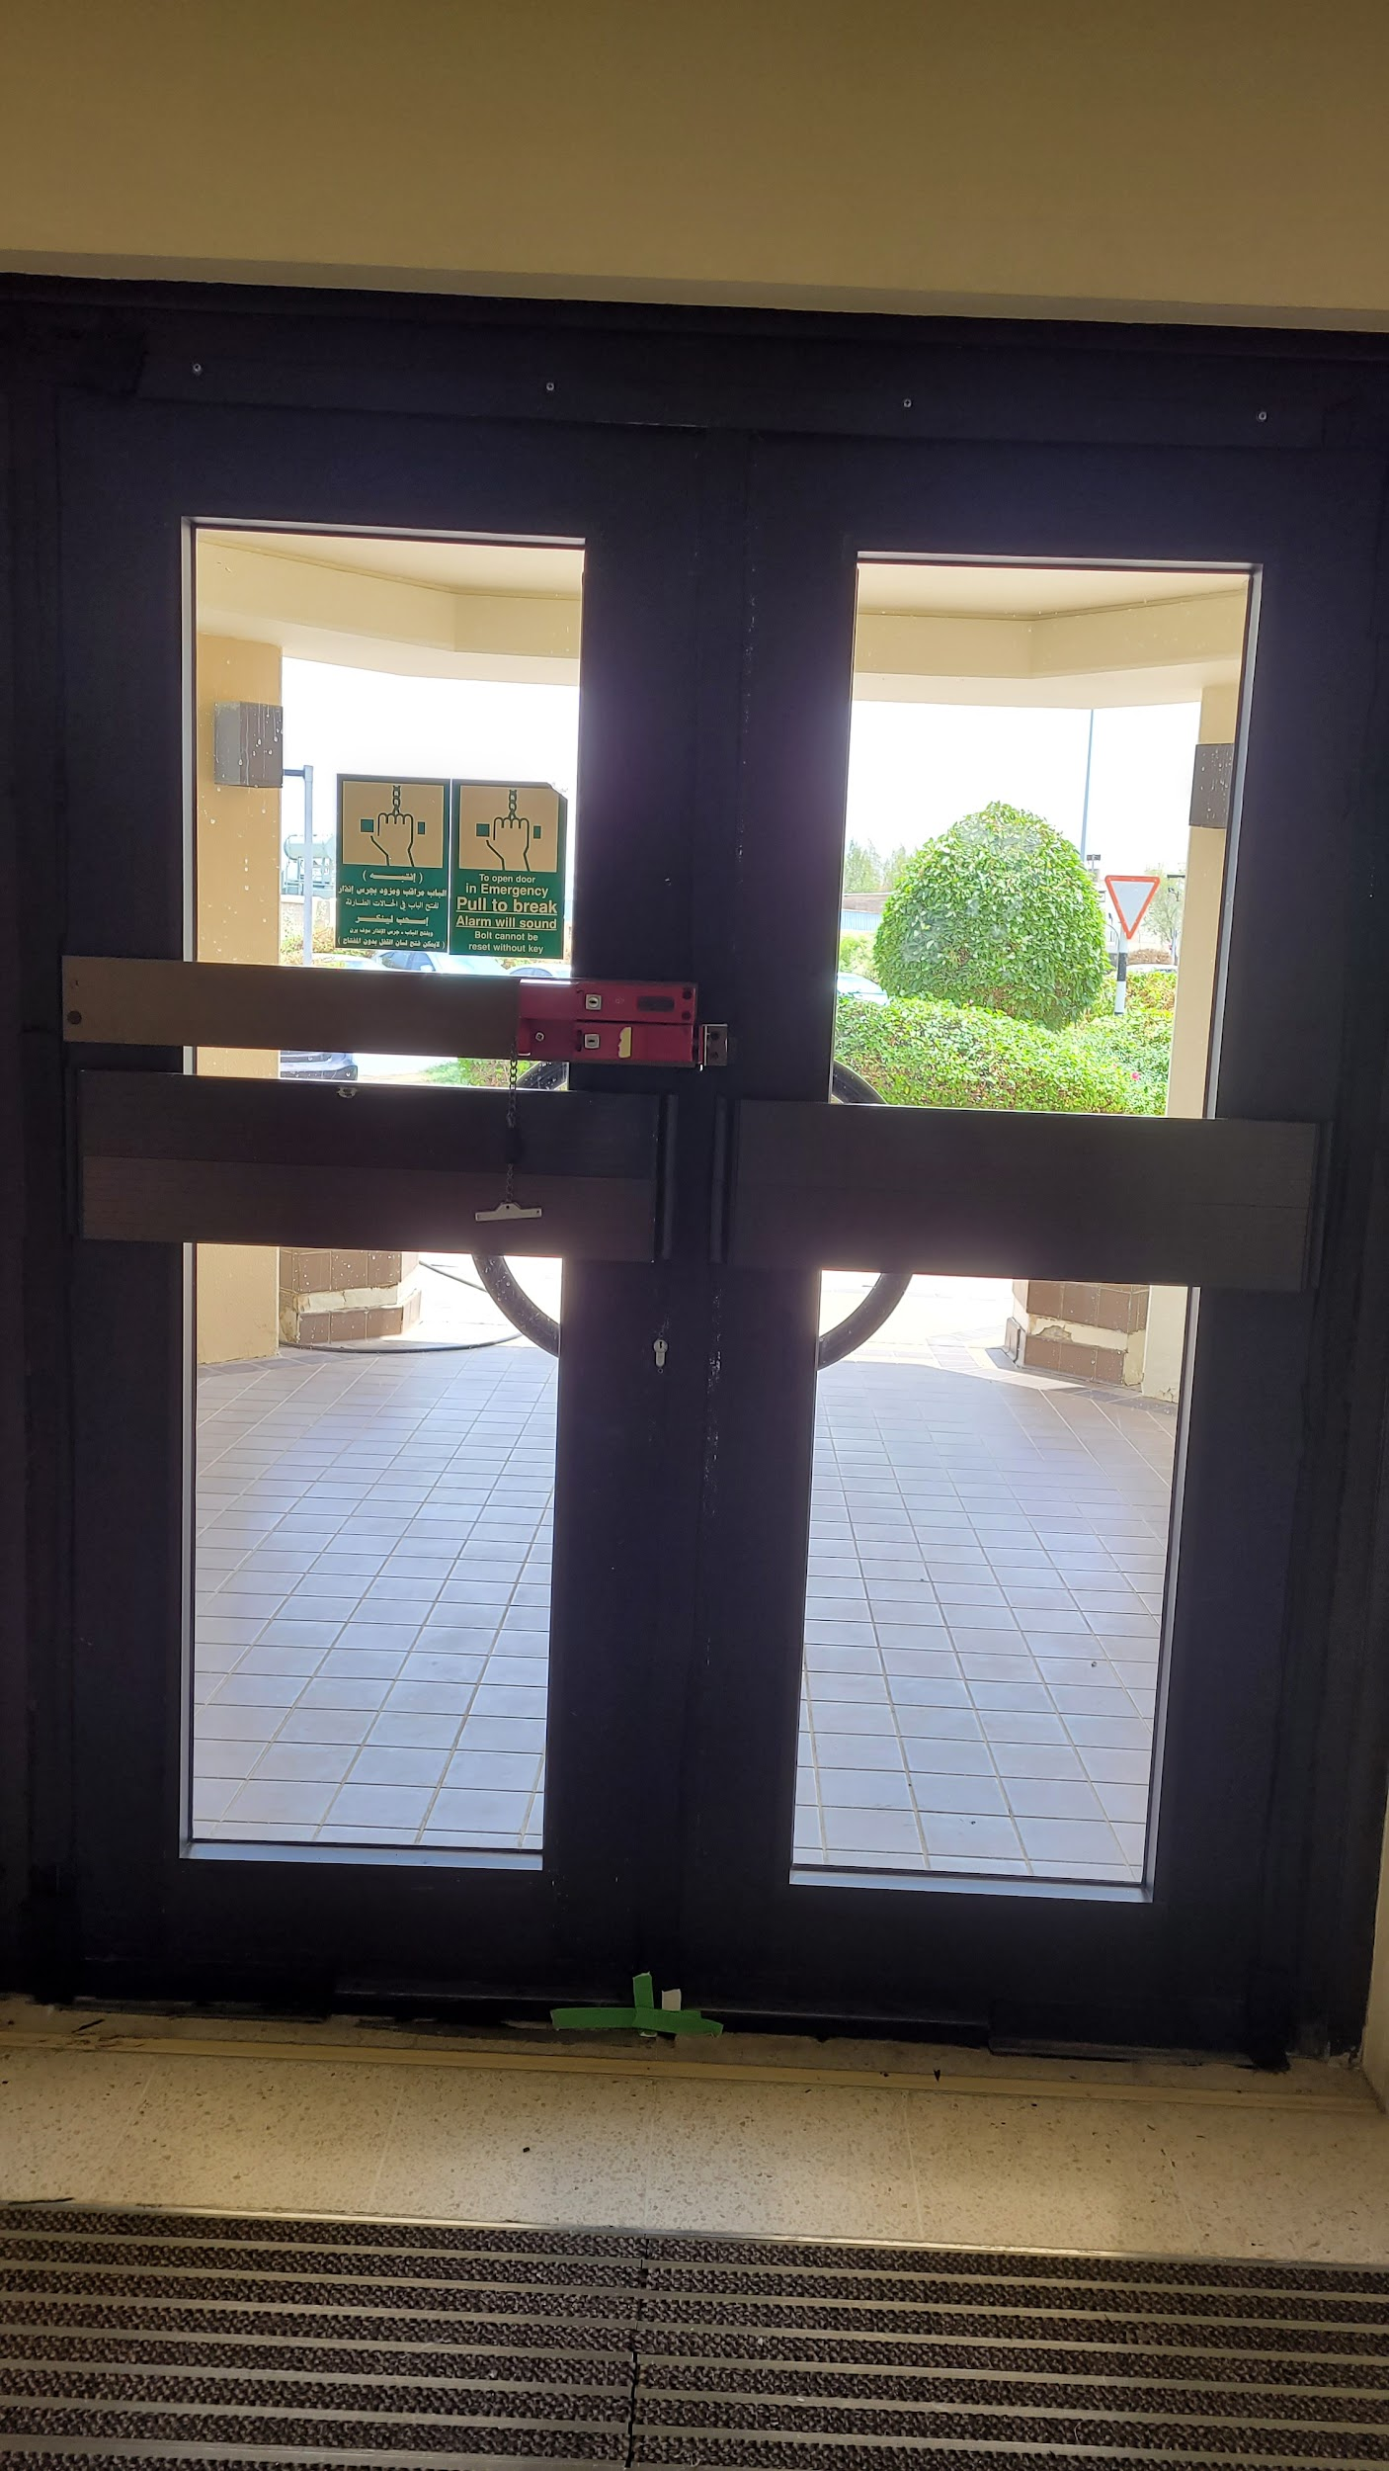


Slide 14
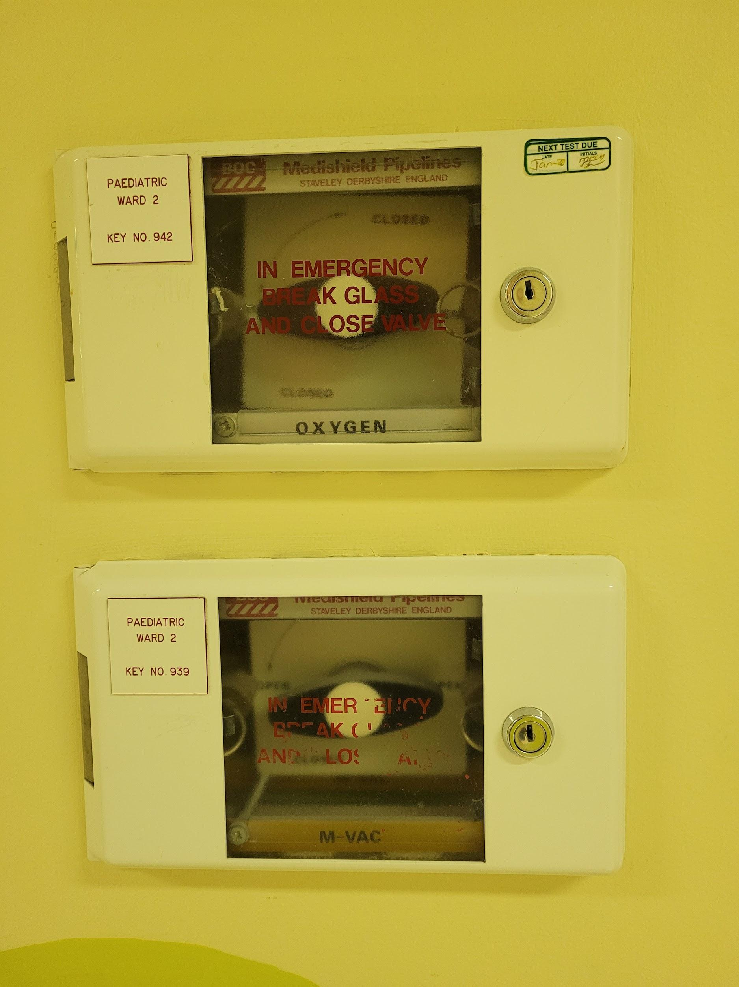
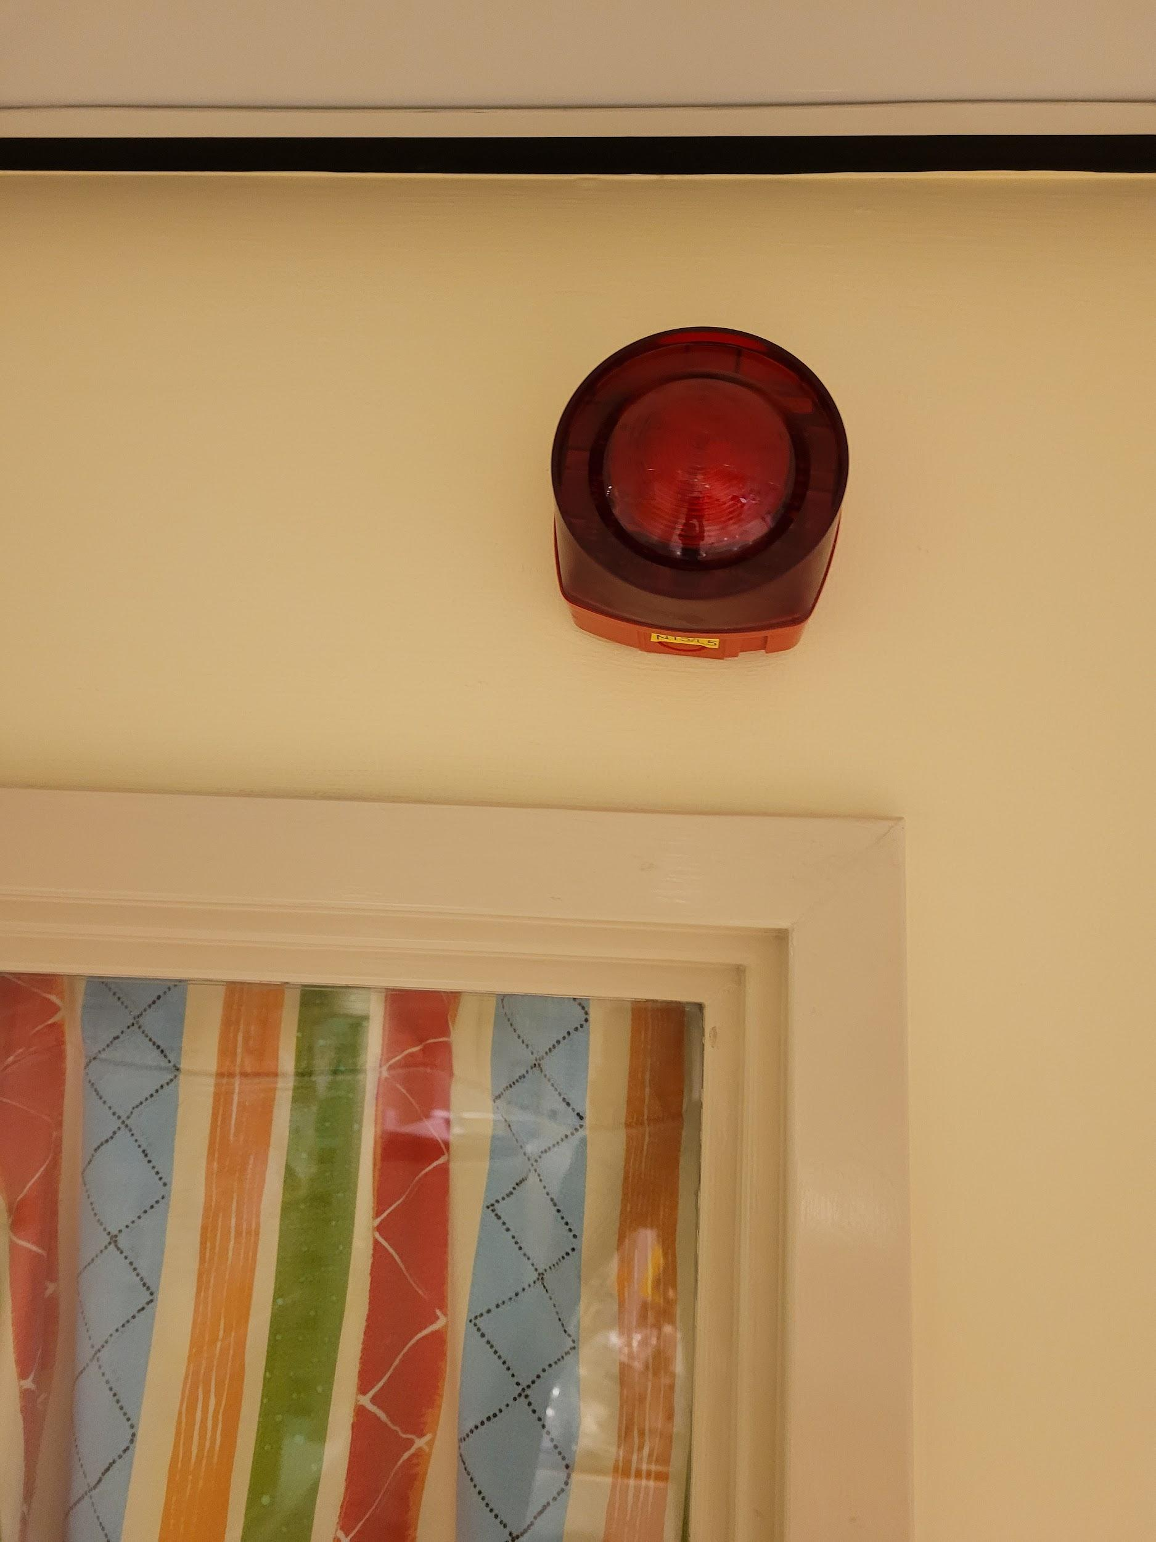
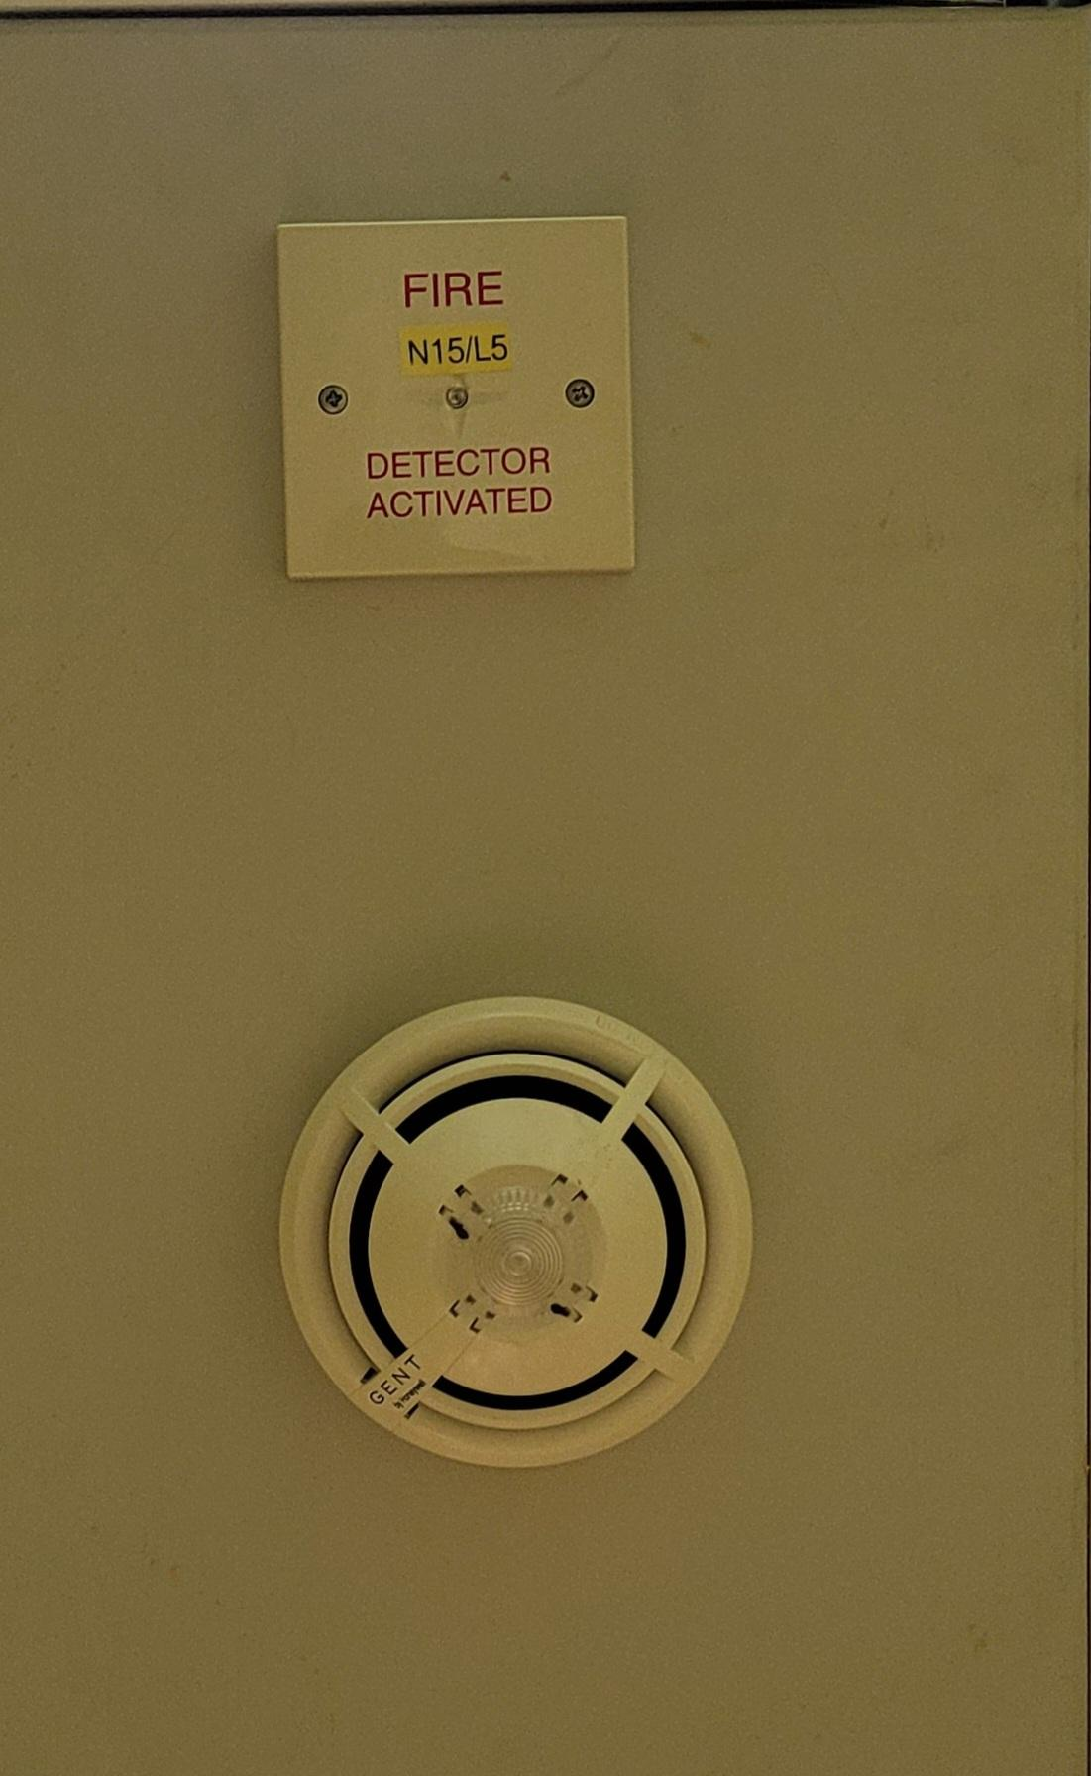

Slide 15
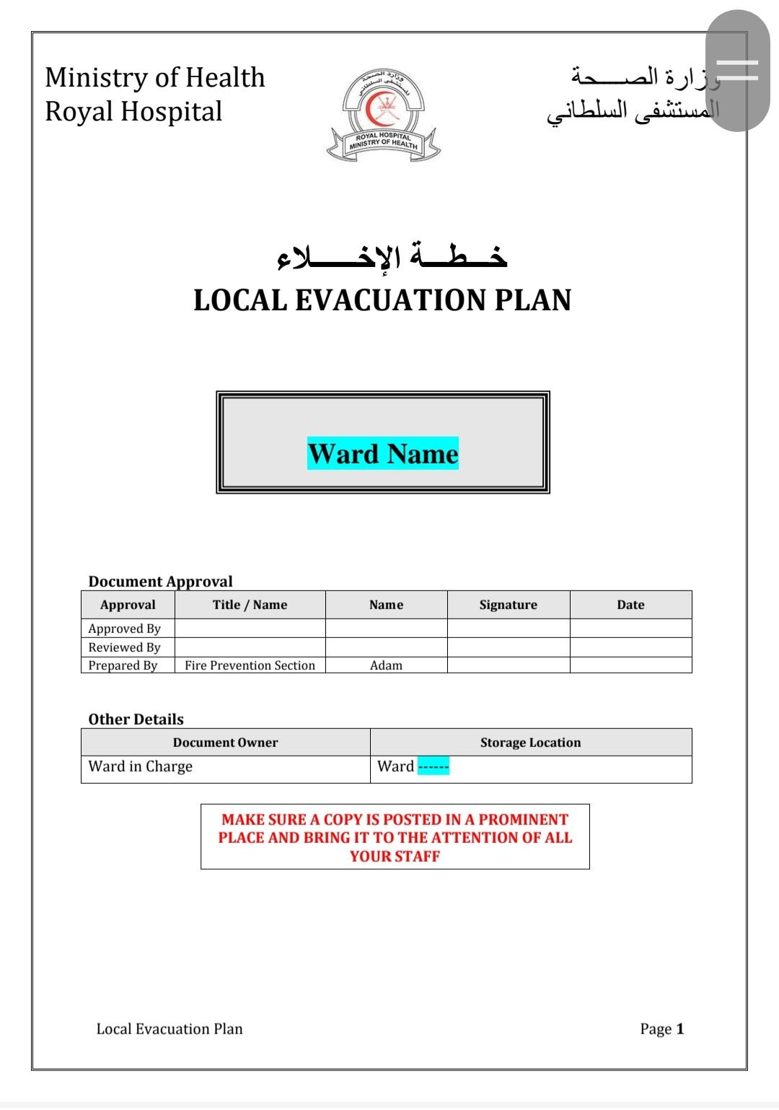

Slide 16
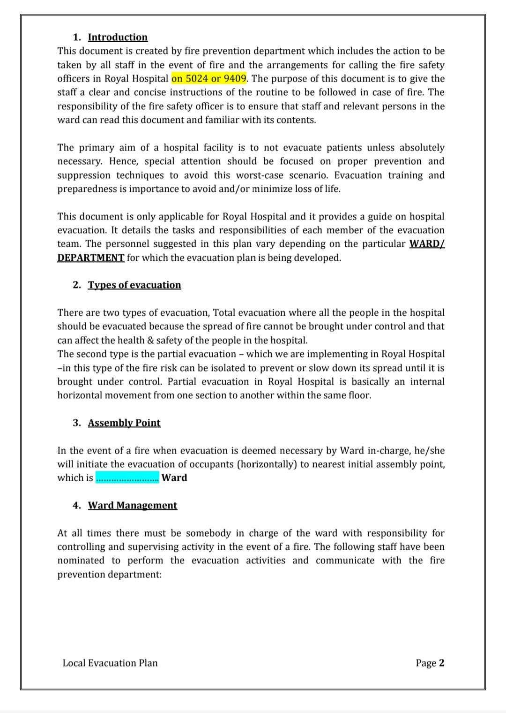

Slide 17
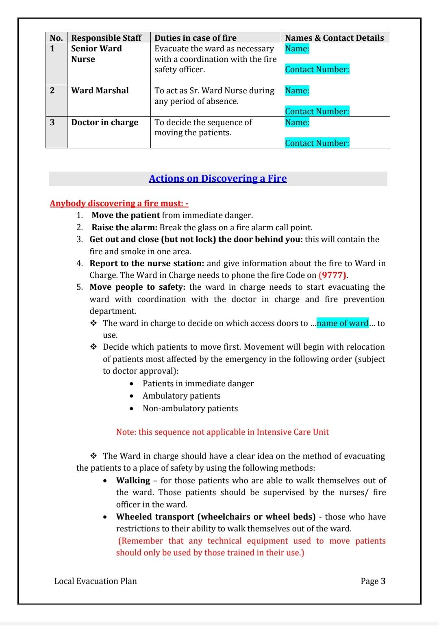

Slide 18
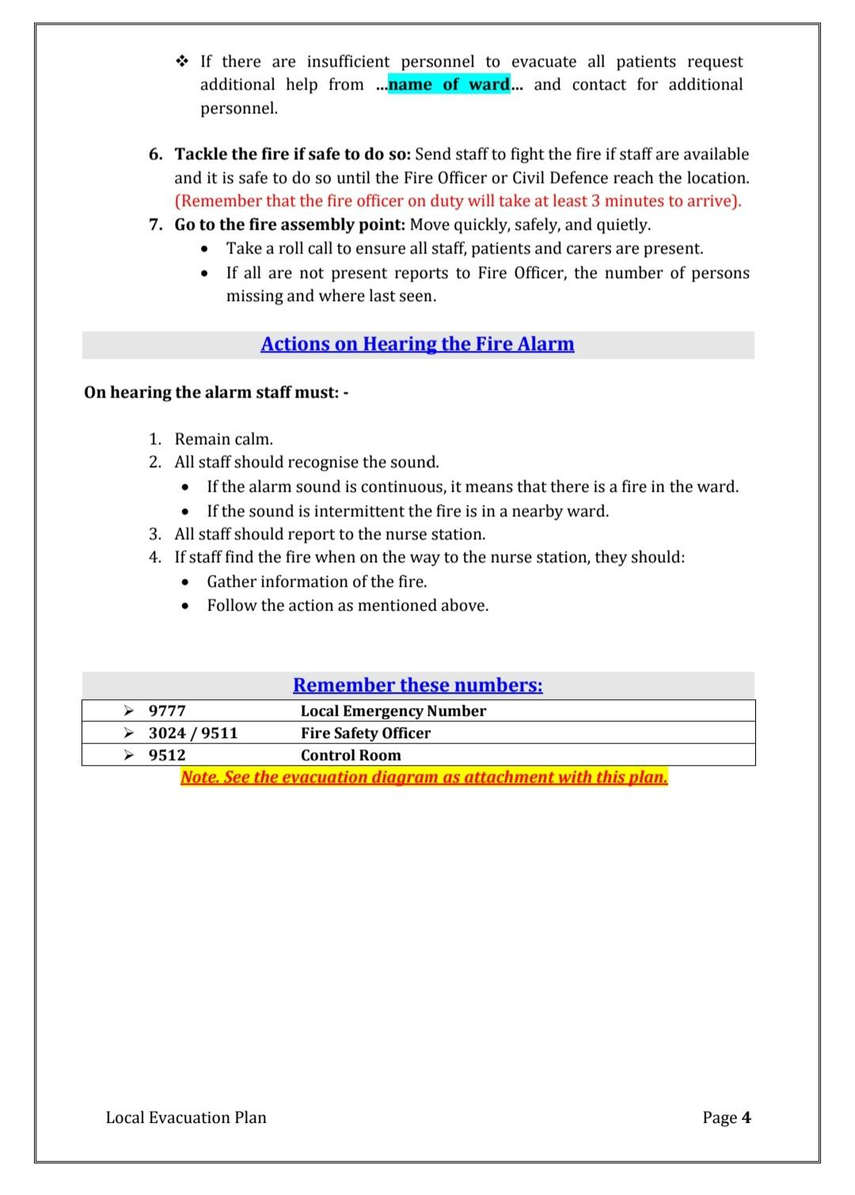

Slide 19
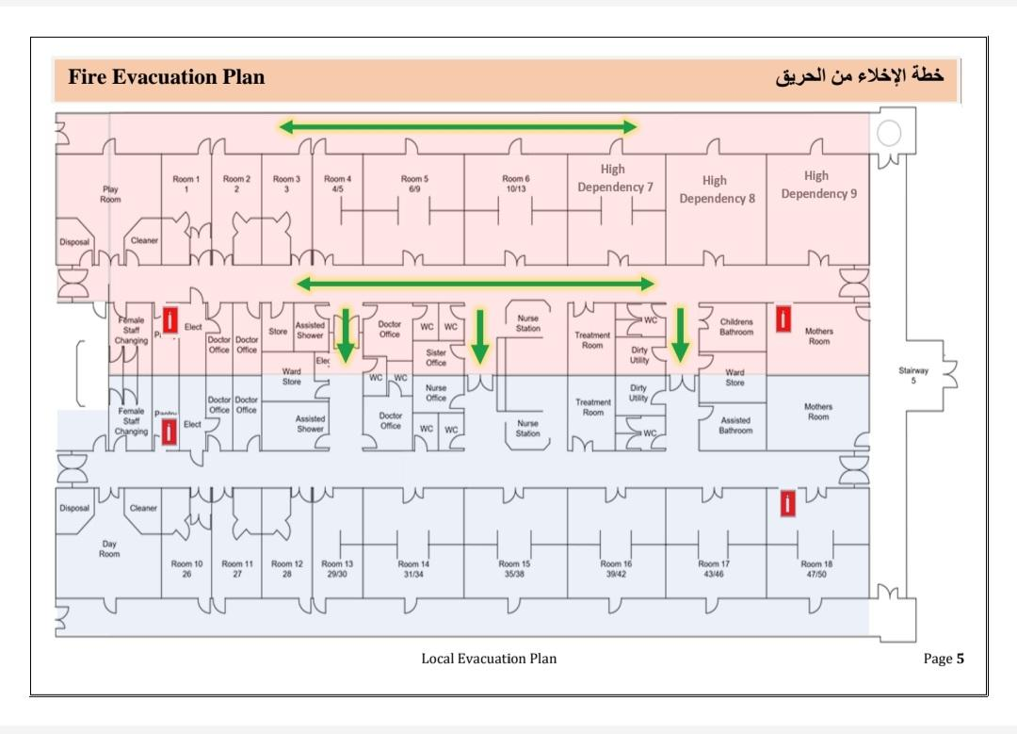

Slide 20


Slide 21
Disaster plan
A disaster is defined as a serious disruption of the functioning of the society, causing wide spread human material or environment loses which exceed the ability of the affected society to cope using its on resources .
Disasters are unpredictable and therefore difficult to prepare
Staffing required during in phdu
One ward nurse, one I/C, one staff nurse for each bed and two helper

Slide 22
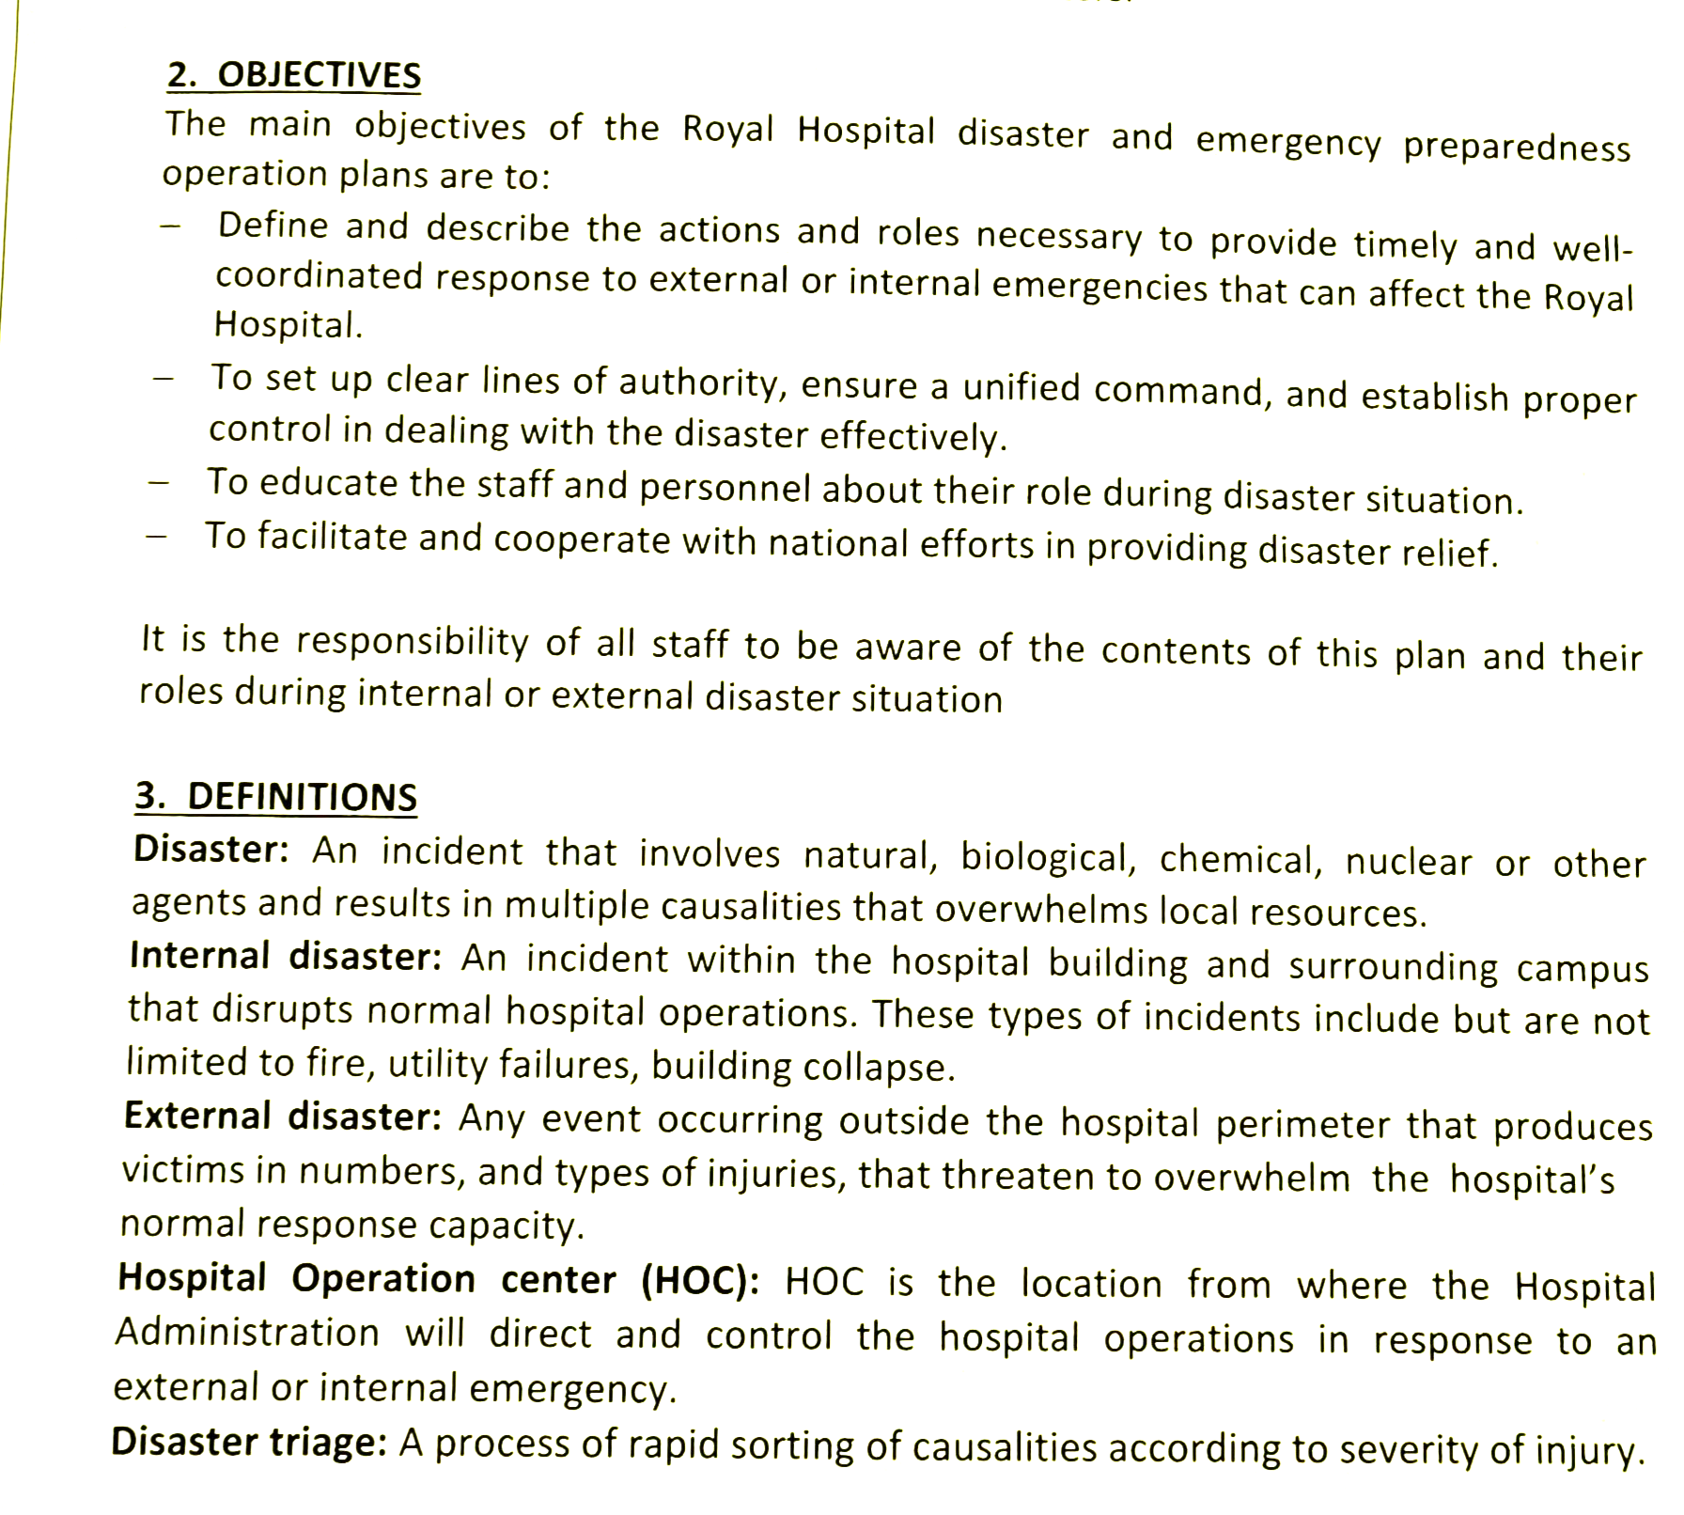

Slide 23
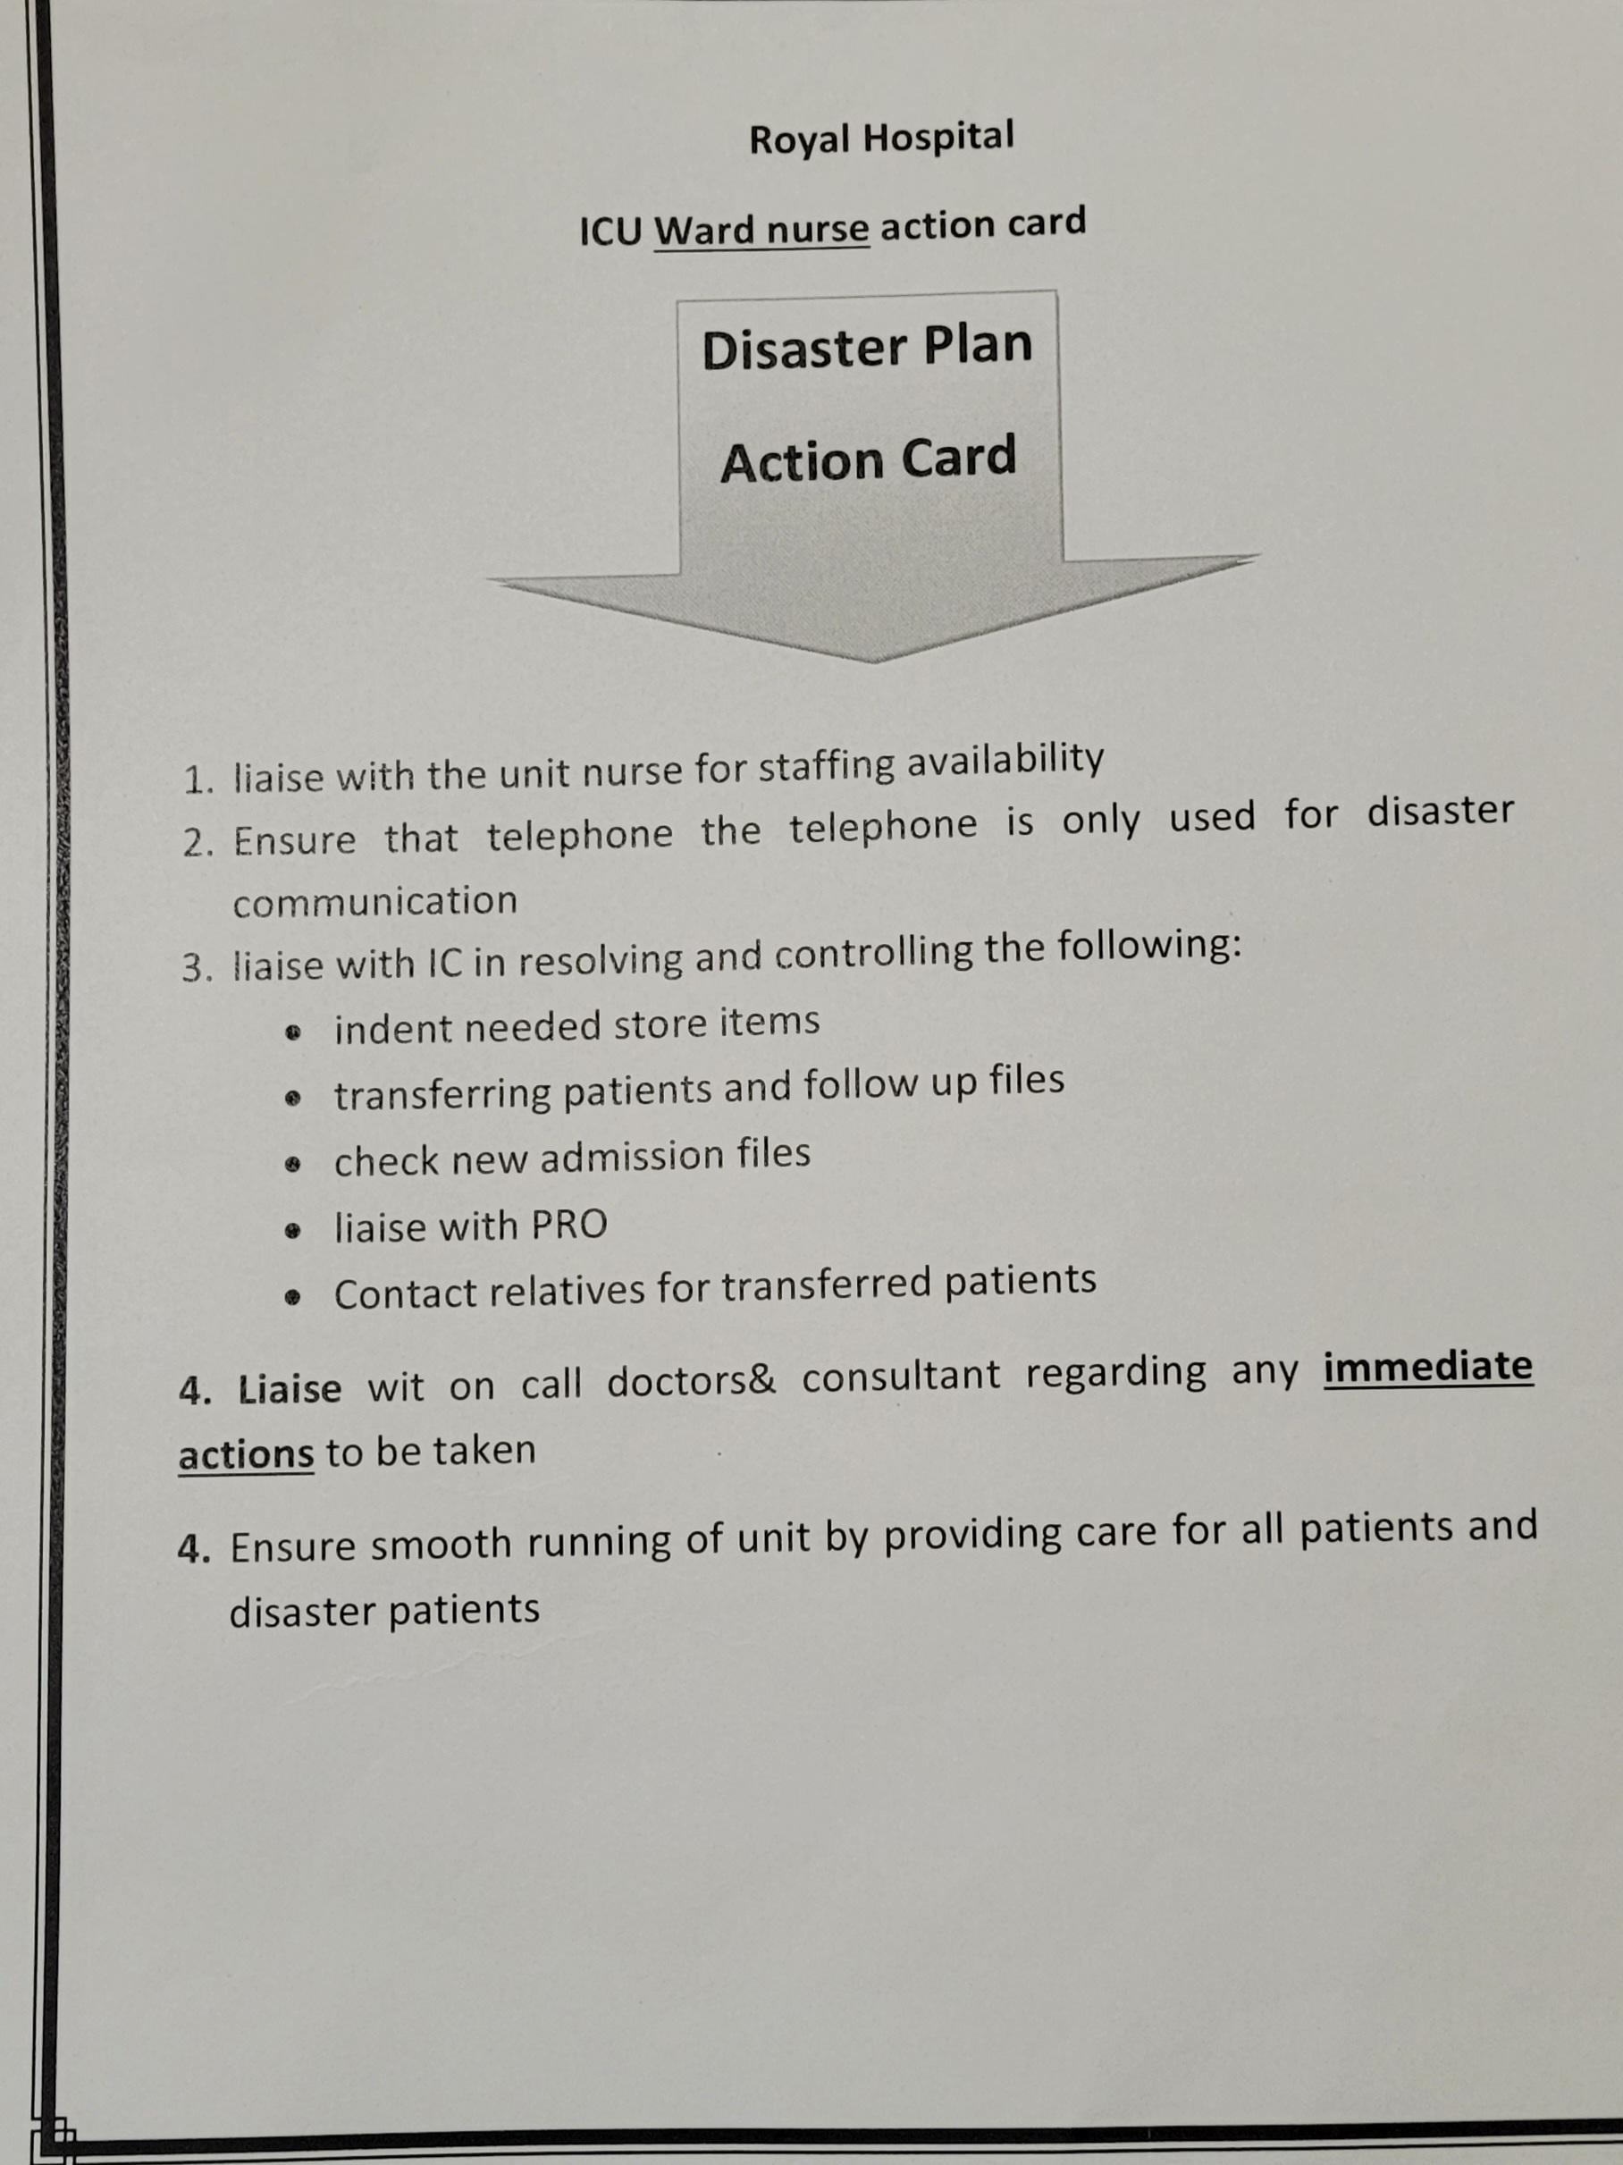

Slide 24
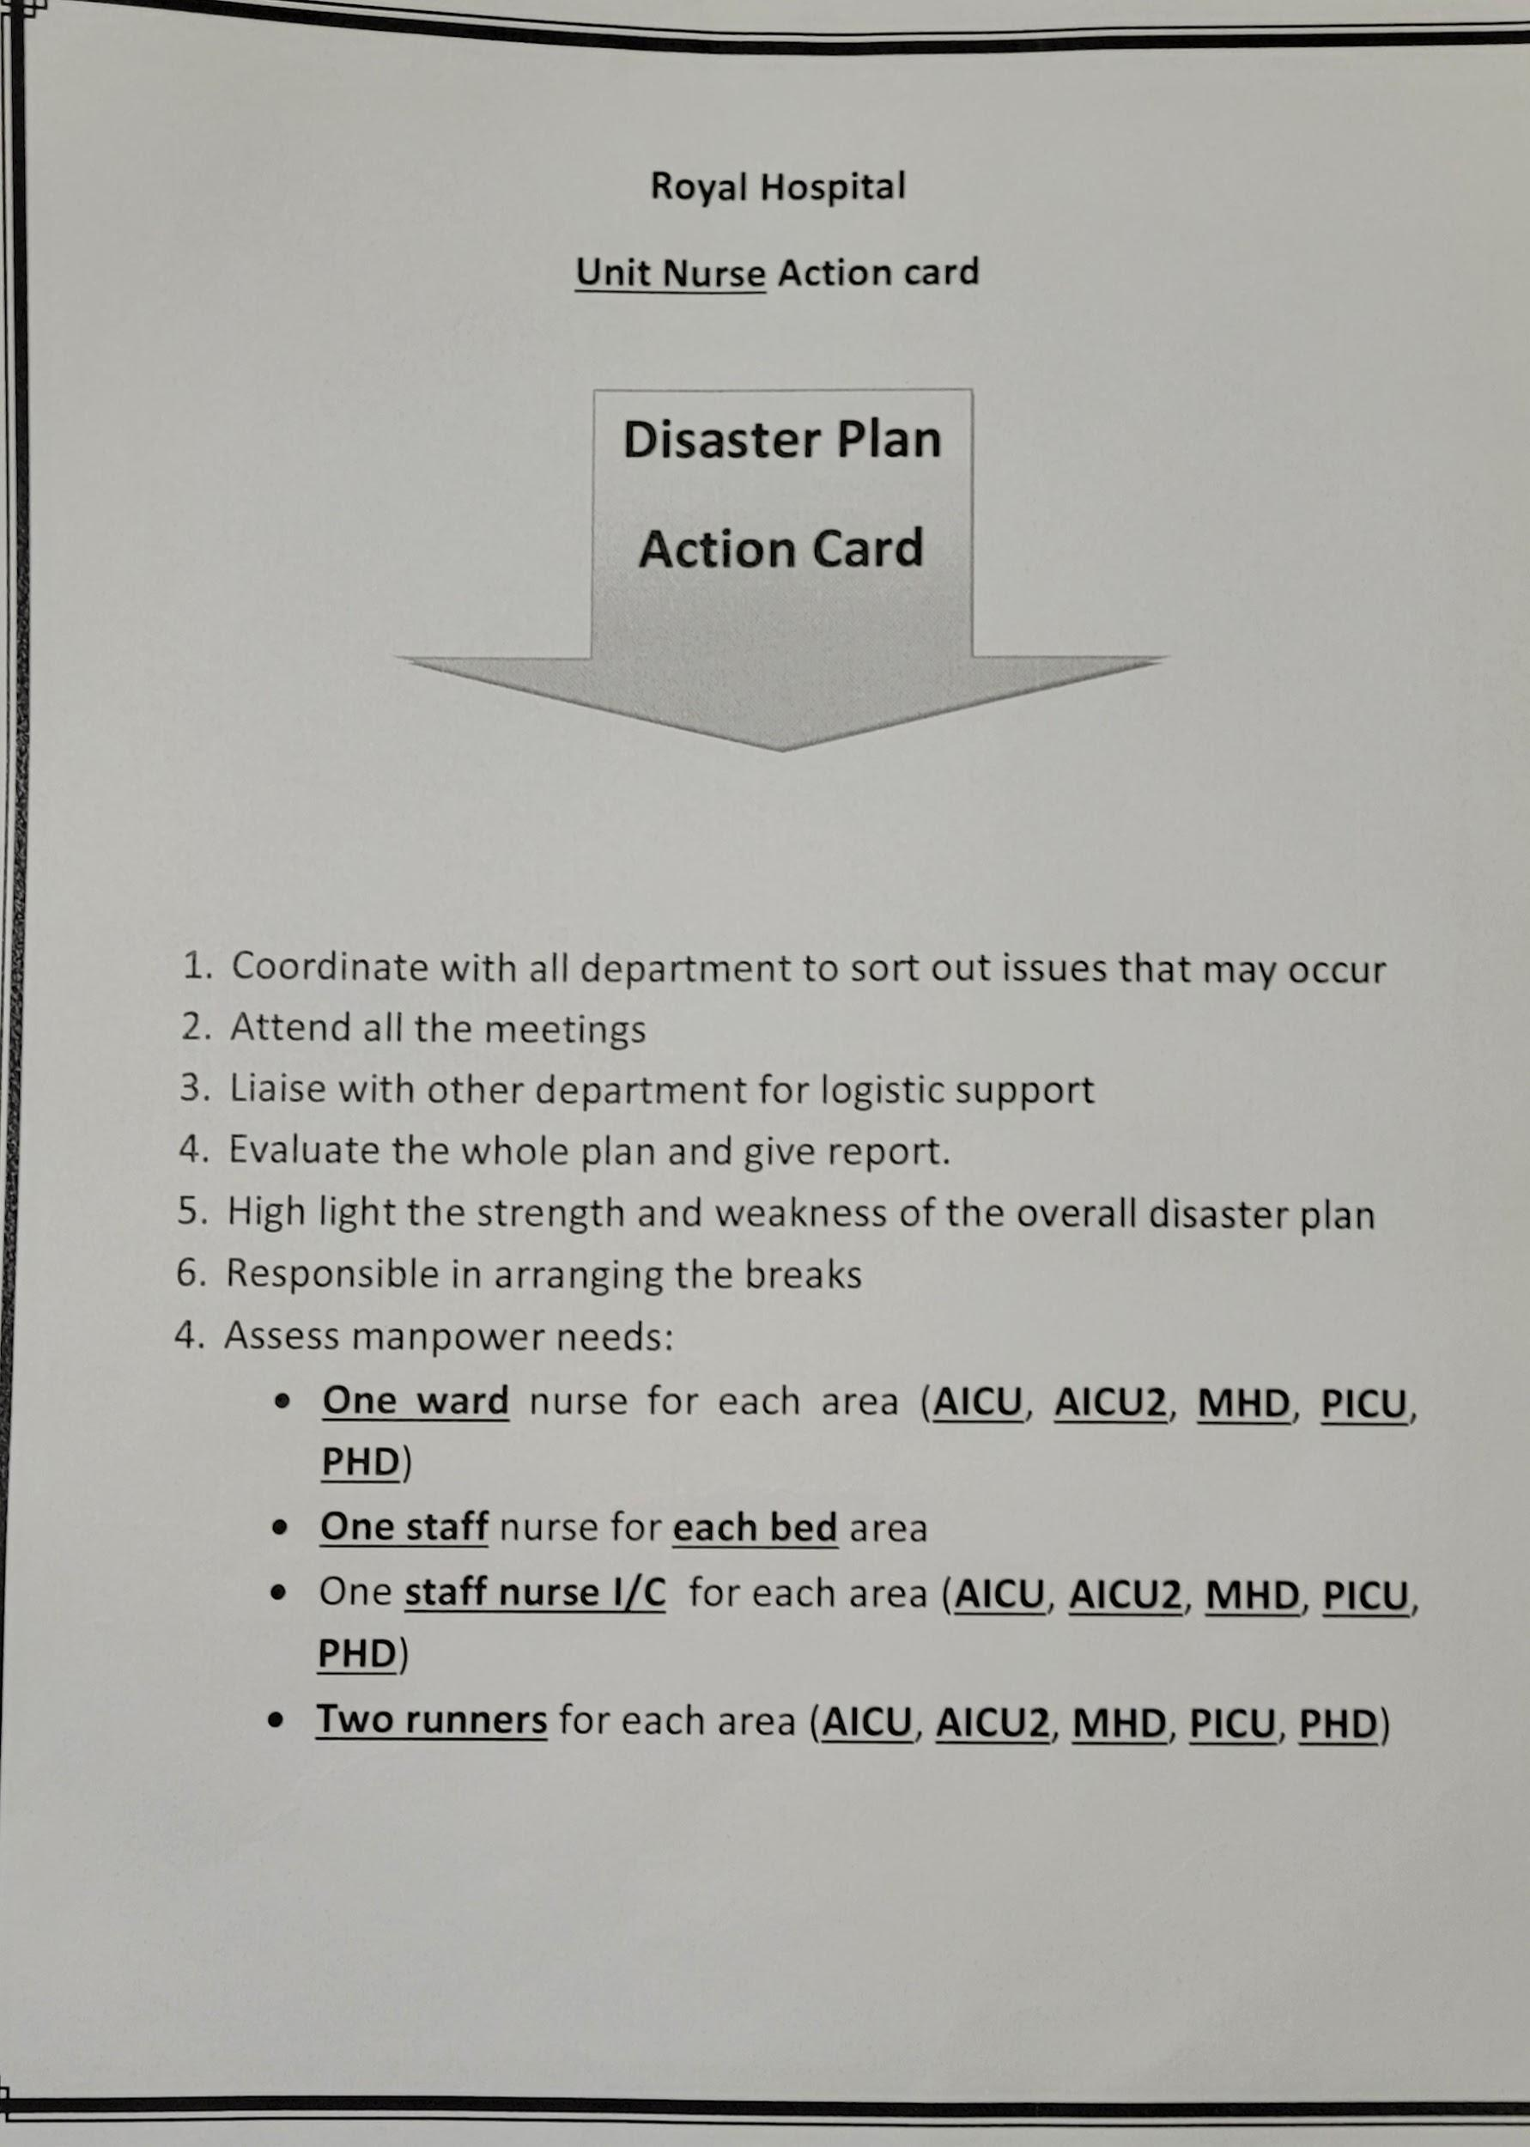

Slide 25
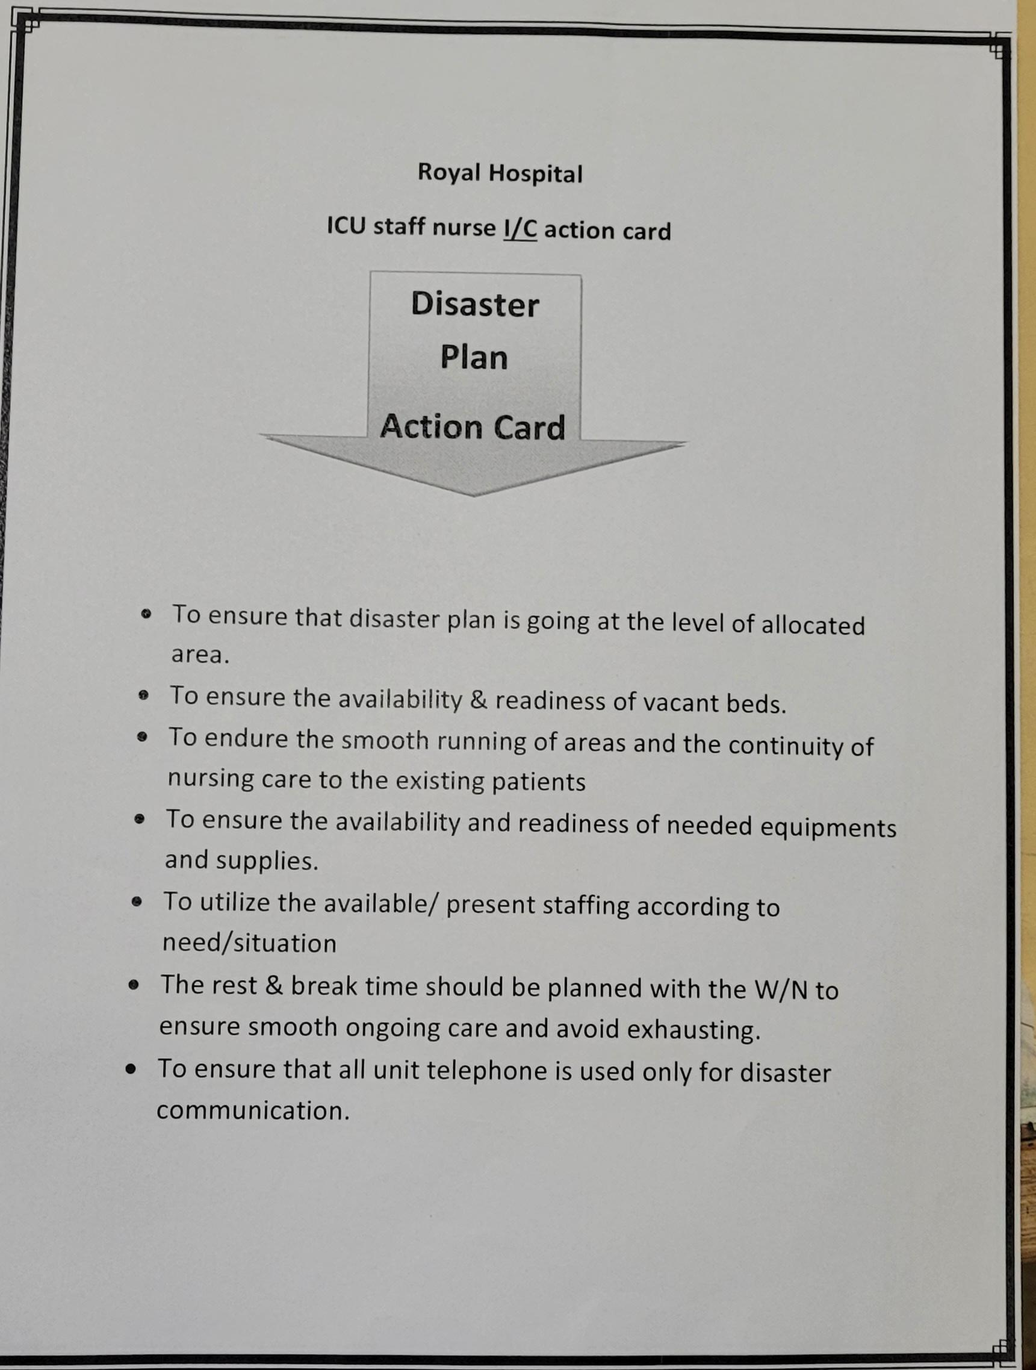

Slide 26
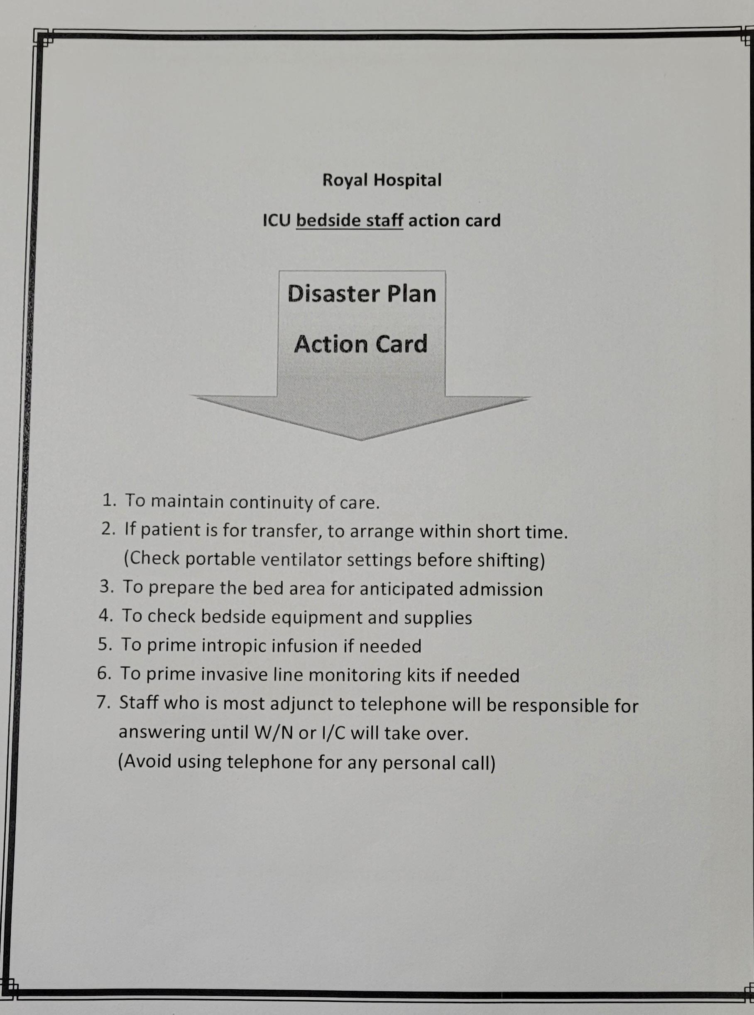

Slide 27
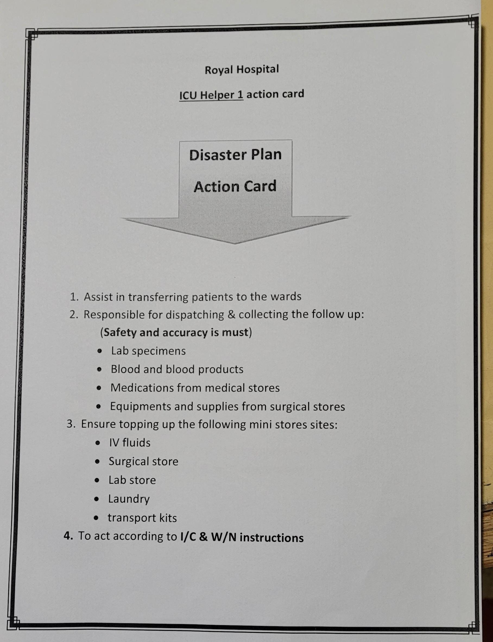

Slide 28
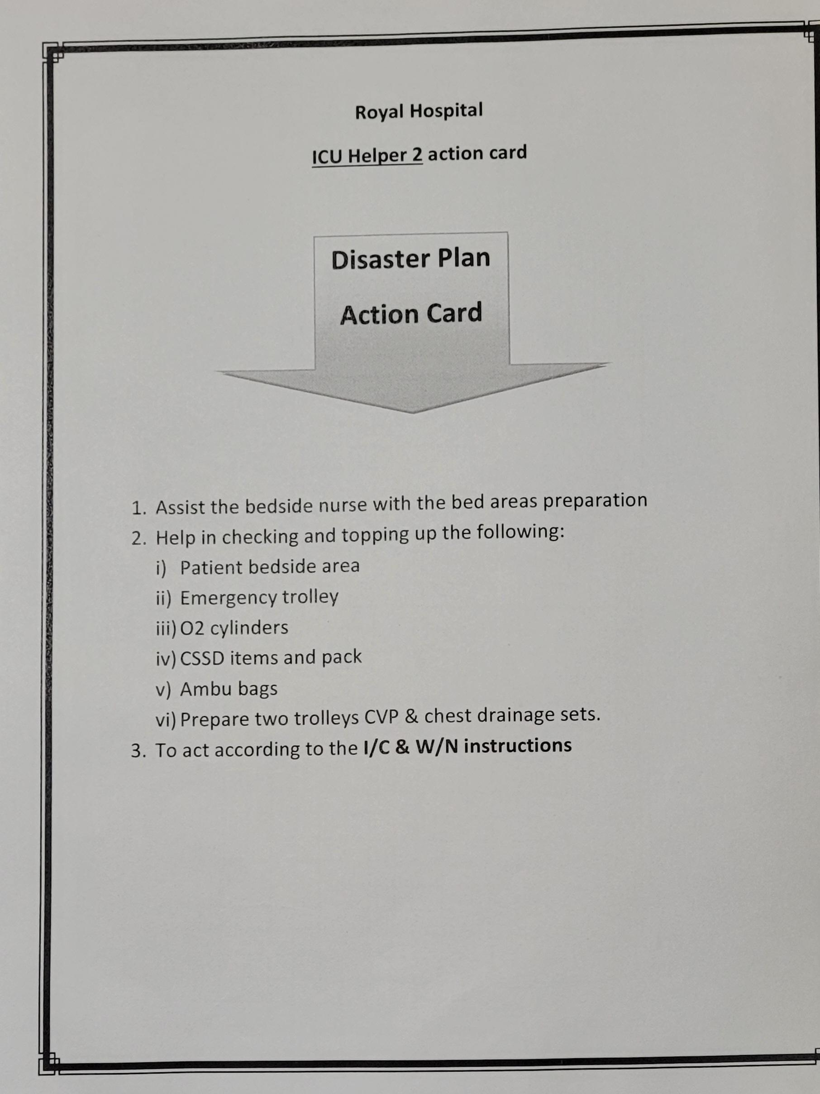

Slide 29


Thank you
-Rinsy Joseph
Thank you

